Slide 1
CSE4019 Image Processing J Component Review 3 Skin Cancer Classification and Melanoma Detection with Medical Assistance using Deep Learning
Gadiparthy Harika Sai – 19BCE1182
Meghna Manoj Nair – 19BCE1459
Jessenth Ebenezer S – 19BCE1462

Slide 2
Modules and Work Distribution
Preprocessing the dataset – Harika
Building and Training the model – Harika
Testing the model – Meghna
UI for Web Interface – Jessenth
Integration of Google Maps API – Meghna
Python Backend Integration – Jessenth
Curating Research Paper - Jessenth, Harika, Meghna

Slide 3
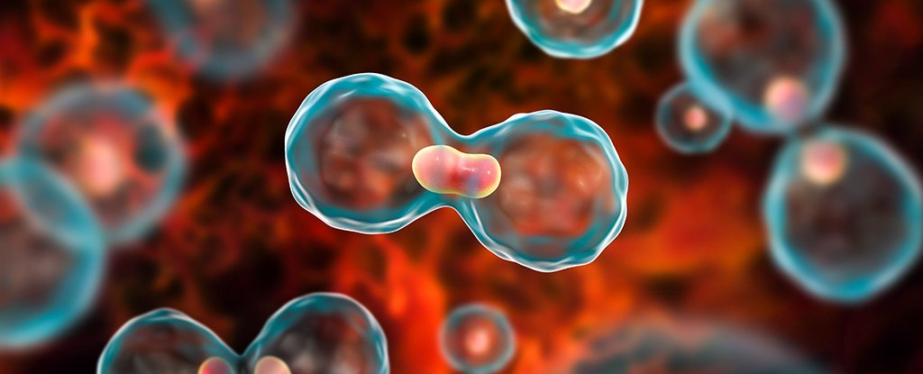
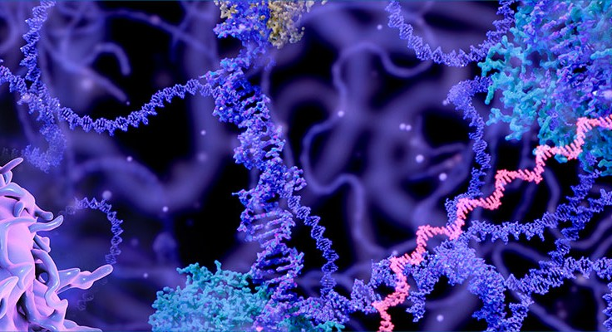
Objective
To classify Skin Cancer and to detect Melanoma using Deep Learning algorithm and to notify the nearby hospitals and health centers to the users which offer suitable treatment based on the location preference of the user.

Slide 4
Abstract
Skin cancer - most prevalent type of cancer.
Melanoma, specifically - 75% of skin cancer deaths, despite being the least common skin cancer.
To combat this issue - Skin Cancer Classification and Melanoma Detection with Medical Assistance using Deep Learning
Convolutional Neural Networks will be used
User uploads scanned copy – model runs – classification and detection – results shown – notify users with the nearby hospitals that offer suitable treatment

Slide 5
Dataset
The dataset used for this project has been obtained from GitHub.
There are three main classes used for training the model:
Melanoma (around 400 images)
Nevus (around 400 images)
Seborrheic Keratosis (around 300 images)
The dataset was originally put forth by International Skin Imaging Collaboration (ISIC) Challenge on Skin Lesion Analysis Towards Melanoma Detection in 2017 and was pulled from there.
Since the dataset has been obtained from the repository of the renowned International Skin Imaging Collaboration, it can be trusted and used efficiently.

Slide 6
Preparing the Dataset
After acquiring the dataset from the repository, we then separate the data into various directories
Training, validation, testing (80% for train data - divide them for train and validation with 90:10 proportion - and 20% for test data)
We then need to transform the dataset by converting all images into equal dimensions and sizes for easy computation in the future.

Slide 7
Methodology
Data Acquisition
Preprocessing
Segmentation
Feature Extraction
Contrast Enhancement
Classification
Integrating Model with Web Application

Slide 8
Building the Model
The next step is to build the CNN model using the VGG-16 architecture which is considered to one of the best classification and detection models till date. The CNN model contains three levels of neural layers to assemble and arrange the architectural aspects – convolutional layer, pooling layer and fully connected layer.
The proposed model has three main phases to complete at its core – feature extraction, detection and classification. Initially, the concurrent layers of convolution are used following which the parallel layers get activated.
After the feature extraction phase, the next step is the classification process. This is achieved by the flattened level fed into a two-layer multi-layer perceptron. All throughout the training process, the dropout layer would keep removing the fully connected layers weights in order to reduce and decrease the chances of overfitting.
The accuracy and validity of the model is tested and is found to be around eighty percent. Further accuracy can be improved up to around ninety percent by training the model for a hundred epochs but due to the limited resources and hardware constraints at hand, we have run the model for only twenty epochs. The precision, recall, and F1-Score are 76.19, 78.15 and 76.92 respectively.
The model is then saved and can be used for the next level of implementation. Fig. 3 elaborates on the internal flow of the working of the neural networks and segmentation within a CNN model.

Slide 9
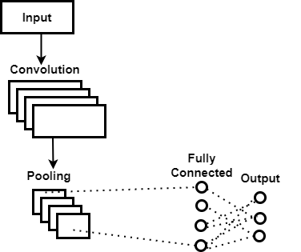
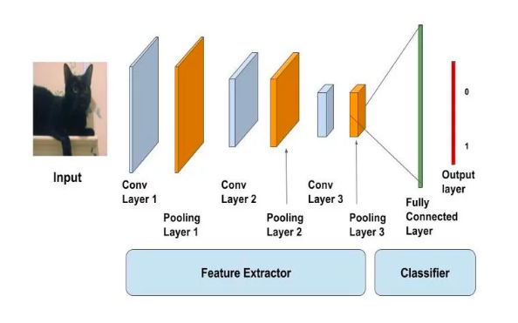
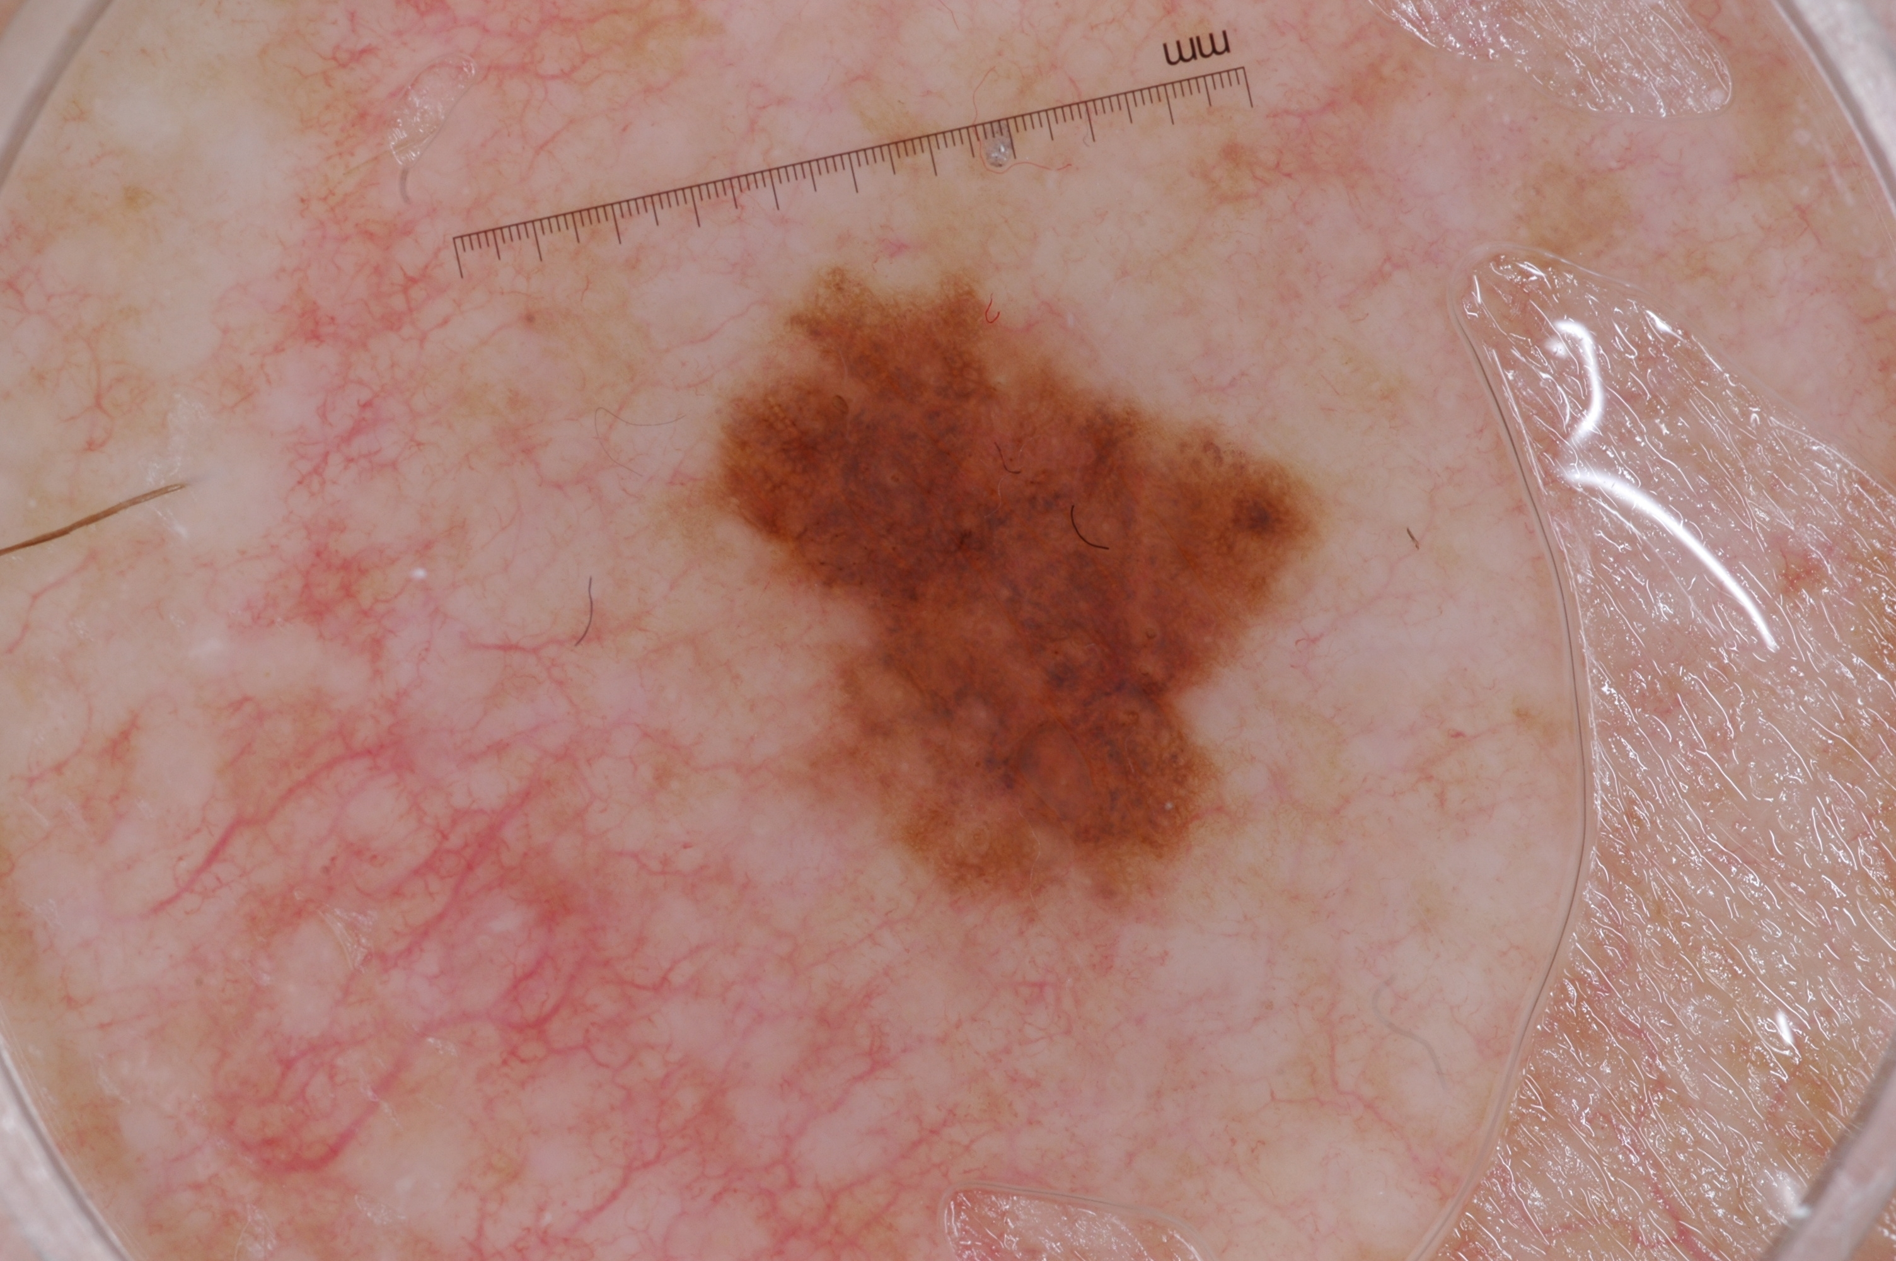
Elaboration on the Working of CNN Model for Skin Cancer Classification
Working of CNN Model

Slide 10
Web Application
The major and final step left in the completion of the project is to utilize the model created in the previous step and to integrate with an application which can be used by the society easily. An interactive, simple and user-friendly Web UI is created using HTML, CSS, JavaScript and Flask. The saved model is then integrated with the Flask framework.
Each time the user uploads an image from the frontend UI, the CNN based classification model is called which extracts the lesion from the segmented image, parses through it and classifies it as Melanoma, Nevus or Seborrheic Keratosis.
The classification is then displayed. Based on the convenience of the user, the app would also request for the user location and then suggest nearby hospitals and clinics which offer suitable treatment.

Slide 11


